Slide 1

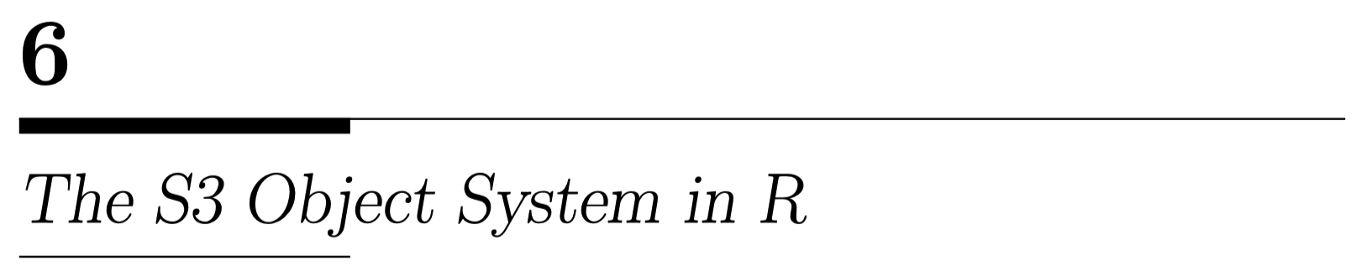

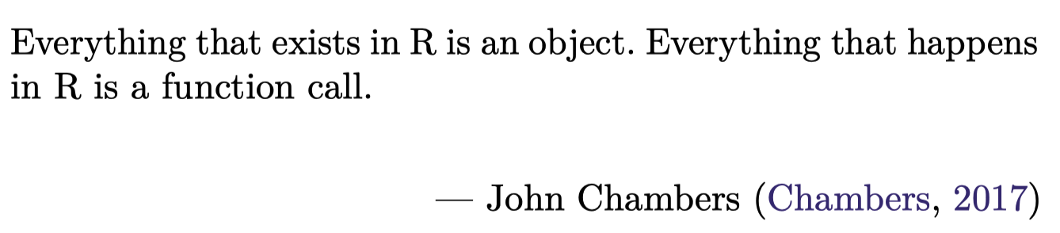
https://github.com/JimDuggan/explore_or

Slide 2
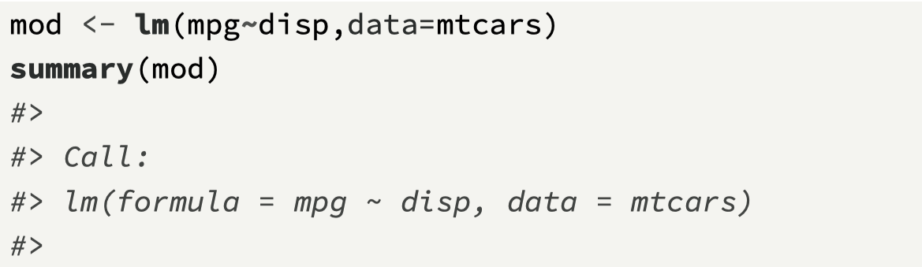
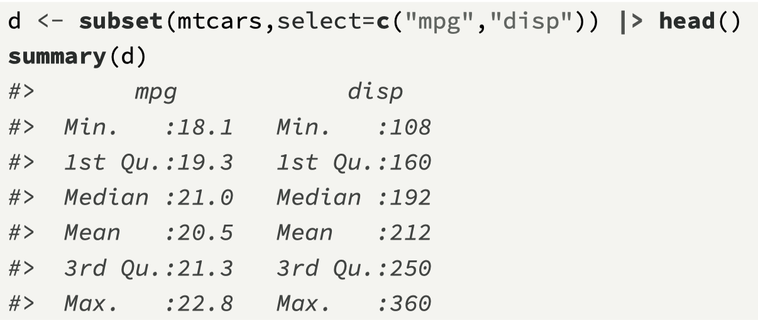
Overview
S3 is based on the idea of coding generic functions (for example, the base R function summary() is a generic function)
We can then write specific functions (often called methods) that are different implementations of a generic function.
The advantage of the S3 approach is that it shields a lot of complexity from the user, and makes it easier to focus on the data processing workflow.

Slide 3
How is this happening?
In both cases, we call the function summary()
However, depending on the variable that is passed to summary(), a different result is returned.
To achieve this, R uses a mechanism known as polymorphism, and this is a common feature of object oriented programming languages.
Polymorphism means that the same function call leads to different operations for objects of different classes (Matloff, 2011).
In effect, R decides “behind the scenes” which method to call.

Slide 4
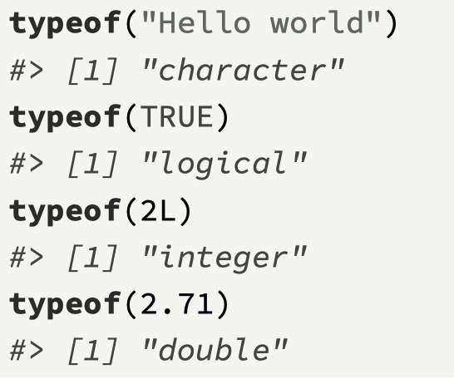
Objects – 2 main types (Wickham 2019)
“Everything that exists in R is an object” – John Chambers
Base objects (also known as base types), were originally part of R (25 types), included atomic vectors (character, logical, integer and double), lists, functions, environments.
S3 objects (object oriented)

Slide 5
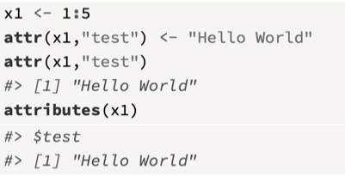
Attributes
An attribute allows us to attach metadata to a base type such as an atomic vector or a list.
The function attr() can be used to set an attribute, and the function attributes() is used to retrieve all the attributes from an object.
R provides much flexibility for adding attributes to base types; for example, we can add an attribute called test to an atomic vector, and then retrieve that attribute.
There are 3 special attributes in R: names, dim, and class.

Slide 6
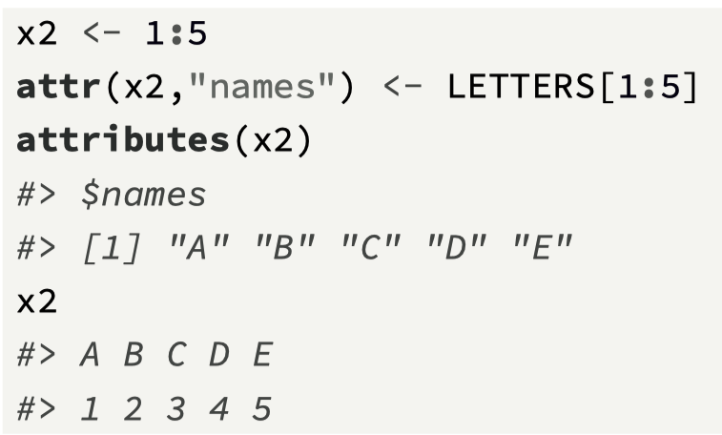
(1) names attribute
The first special attribute (which we already have used) is names, which stores information on the element names in an atomic vector, list, or data frame.
Previously we used the function names() to set these values, but because names is a special attribute, we can achieve the same result by using the attr() function.
Usually, using attr() is not the best way to set vector names, and the function names() is used instead.

Slide 7
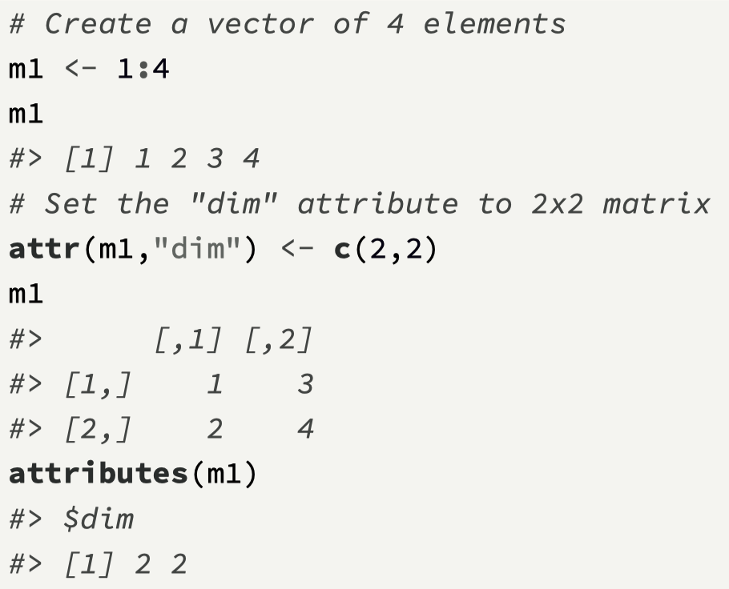
(2) dim attribute
The second special attribute is dim, and this is an integer vector that is used by R to convert a vector into a matrix or an array.
Notice that setting this attribute has a similar effect of creating a matrix.
Normally this mechanism is not used, and the matrix is created using the matrix() function.

Slide 8
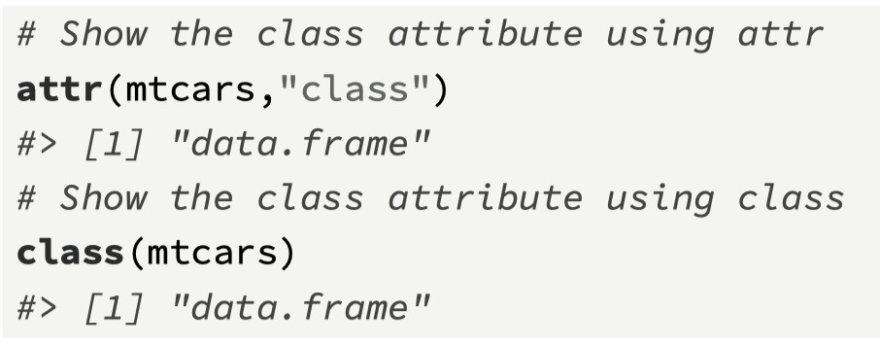
(3) class attribute
The third special attribute of base types is known as class, and this has a key role to play in the S3 object oriented system.
An S3 object is a base type with a defined class attribute.
The key point is that when the class attribute (e.g. data.frame) is defined for a base type, R then views the object as an S3 object, and so can apply the mechanisms of S3 to this object.
The function class() can also be used to view the class attribute.

Slide 9
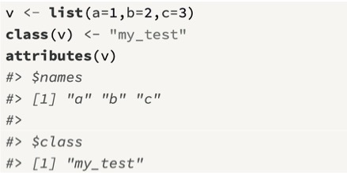
Defining a class
Unlike other object-oriented languages, S3 has no formal definition of a class
To make an object an instance of a class, the class attribute is set using the class() function.
This attribute must be a character string, and it is recommended to use only letters and the character “_”

Slide 10
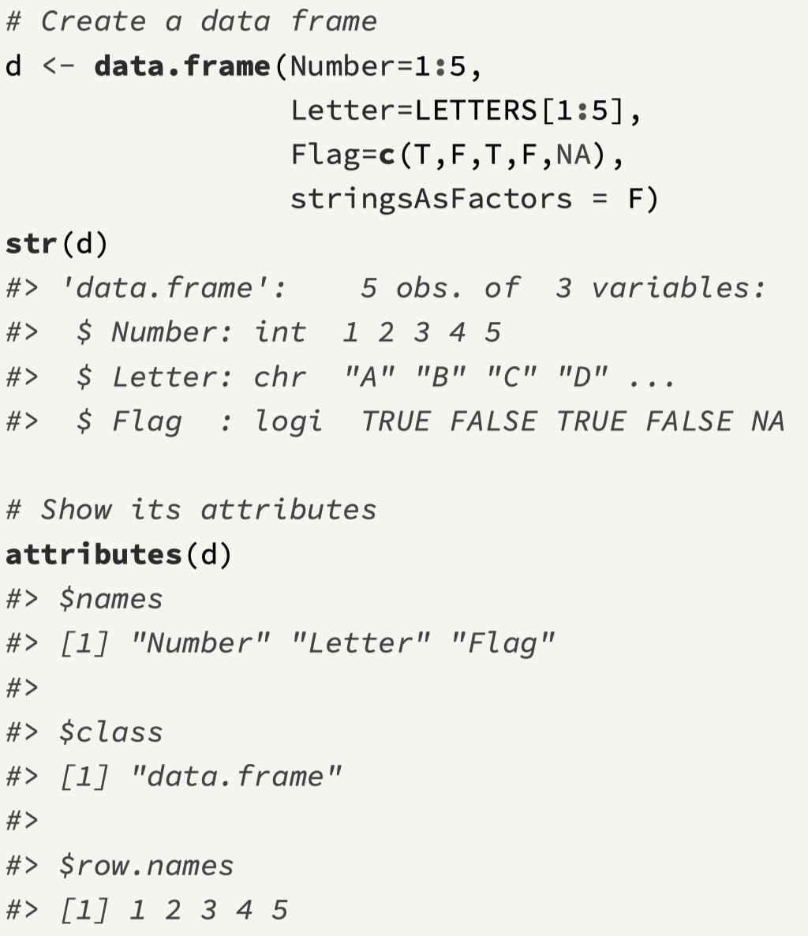
Manipulating the class attribute
What is also interesting is to see how a simple manipulation of the class attribute can lead to different behaviors.
First, we define a data.frame object and show its structure, attributes, and whether it is viewed as an S3 object by R.
We can see that the class attribute is data.frame, and so all behaviors associated with a data frame will apply (for example, subsetting, summaries, etc.).

Slide 11
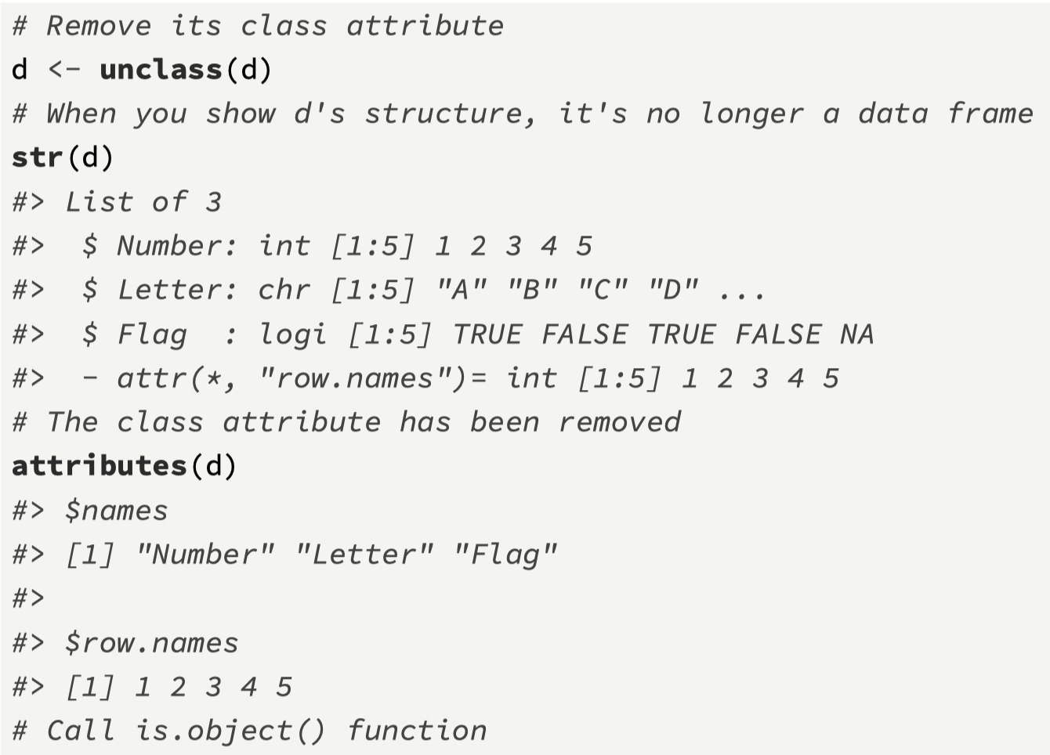
Removing the class attribute
Next we make just one minor change to the object d by removing the class attribute.
For this, we use the function unclass(), which deletes the class attribute.
This simple action totally changes the way R views the object. It is now no longer an S3 object, and instead is just viewed as its base type, which is a list

Slide 12
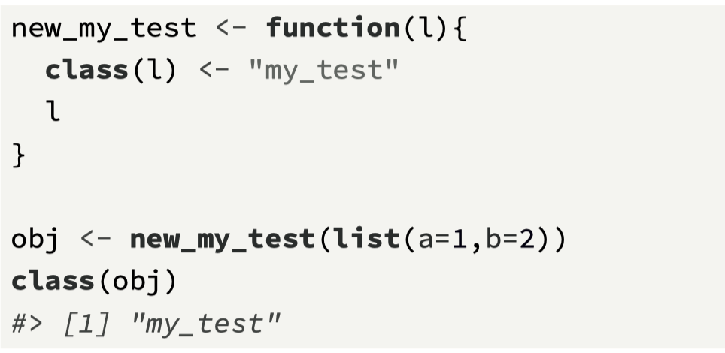
Usually, we code a constructor function for S3 objects
It is best practice to write a constructor function to create the new S3 object.
For example, the function new_my_test() will create an object of class “my_test”.

Slide 13
Summary
In R, everything that exists is an object (Chambers, 2017), and objects are either base objects or object oriented (e.g., S3) objects.
All base objects in R are of a particular type; for example, an atomic vector of characters, a function, or a list (there are 25 types in all, but in reality you don’t need to be concerned with knowing all of these).
All base objects in R can have attributes. These can be user-defined, but mostly they are special attributes defined using existing R function, for example names, dim and class.
A variable must have its class attribute set to a character string in order for it “to exist” as an S3 object.
The function is.object() can be used to test whether an object is an S3 object.
Once an object is an S3 object, you can perform many interesting things with it.

Slide 14
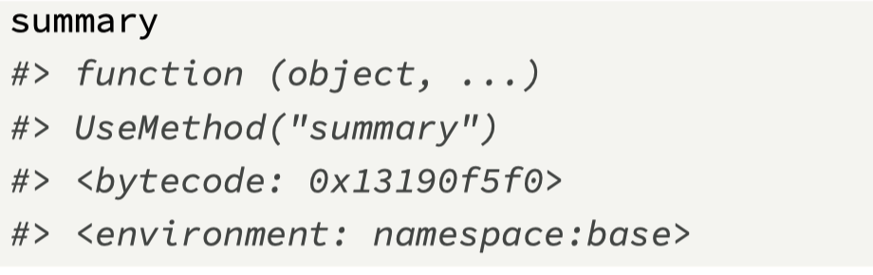
The generic function approach
Earlier we introduced the concept of polymorphism, which is a key idea in object oriented programming.
It allows a programmer to separate a function’s interface from its implementation, which makes it possible to use the same function for different kinds of input (Wickham, 2019).
This is known as functional object oriented programming, where S3 methods belong to generic functions.
An example of a generic function is summary()
Two (of the many) methods that belong to this generic function include summary.lm() and summary.data.frame()
Notice that the methods that belong to the summary() generic function have the format
summary.class_name(object, arg1, . . . )
Note that it has just one line of code, which is UseMethod("summary").

Slide 15
The process (behind the scenes)
When the user calls a generic function, they pass an object, which is usually has S3 class attribute. For example d will have the class attribute data.frame
R will then invoke method dispatch, which aims to find the correct method to call
Once R finds this method, R will call the method with the arguments, and let the method perform the required processing.
The object returned by the method will then be routed back to the original call by the generic function.
As summary() is a generic function, this call summary(d)
will route the call to summary.data.frame(d) and then
relay back the results.

Slide 16
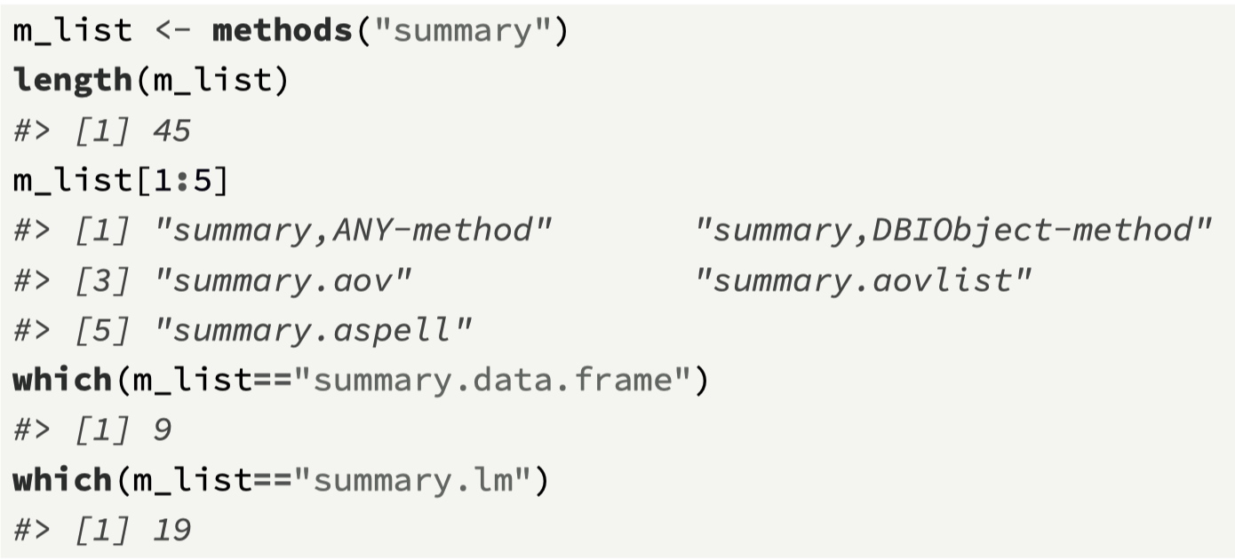
Exploring other summary methods
The R function methods() is helpful, as it will return a list of available methods for a given generic function, where the input is a string version of the method.
We can see this in the following call, which lists all the different methods associated with the generic function summary().

Slide 17
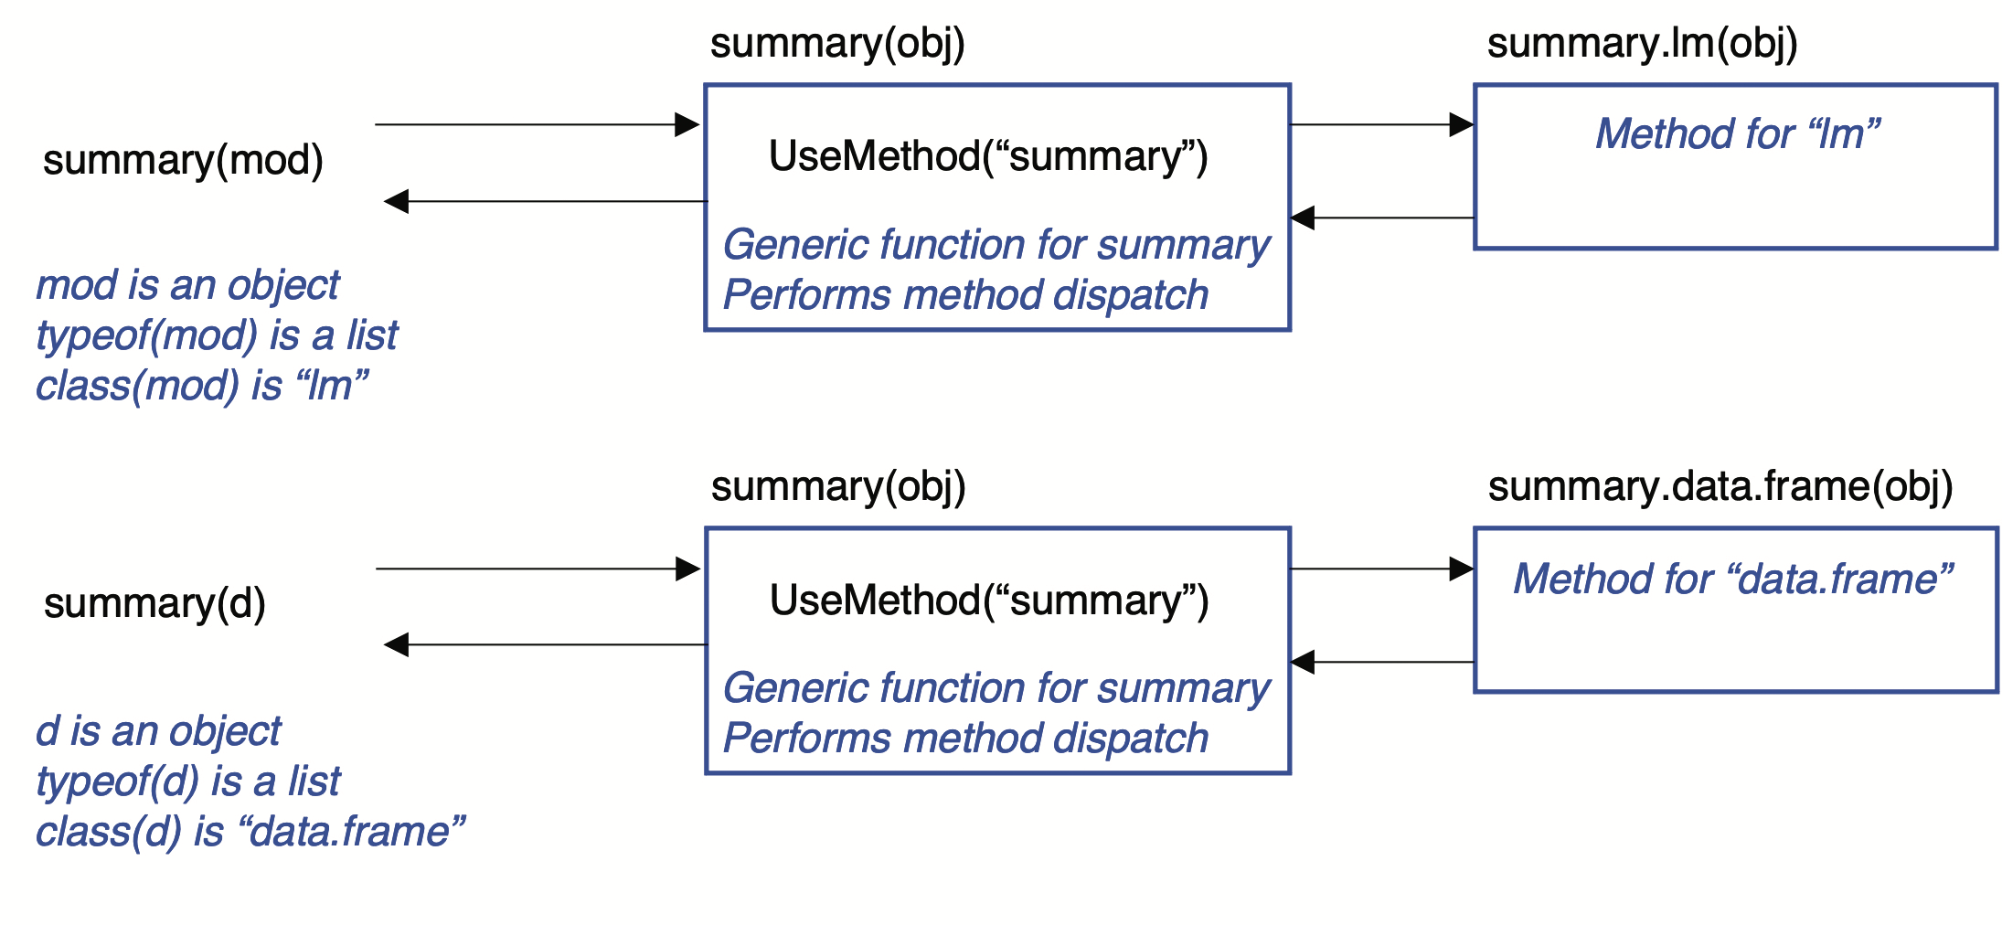
An overview of how polymorphism works
We separate the interface from the implementation

Slide 18
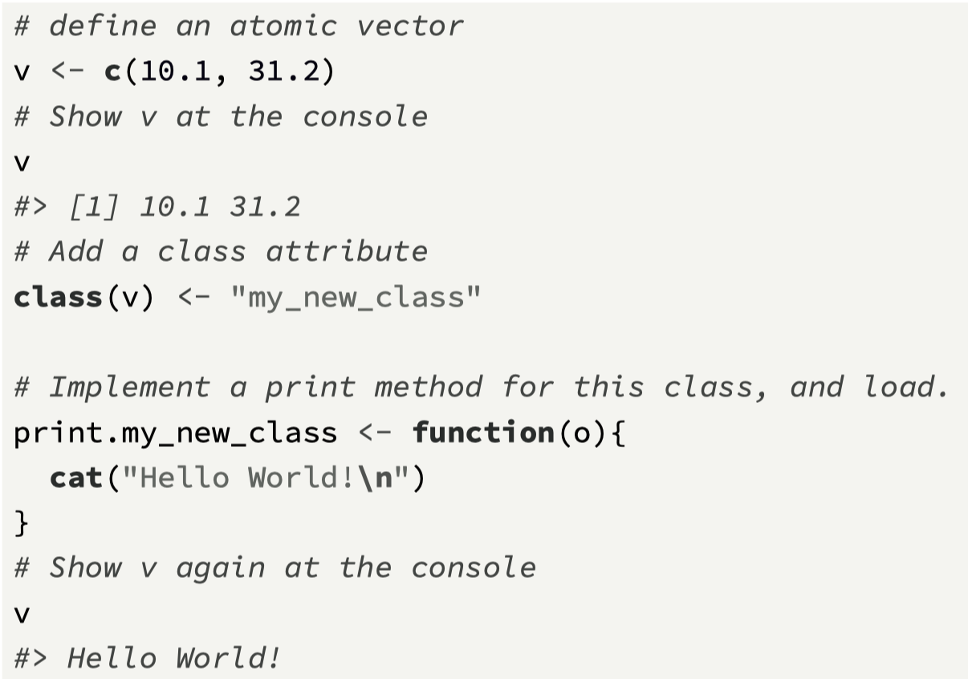
Example 1: using an existing generic function
When using polymorphism with S3, most likely you will use existing generic functions already available within R, for example, summary(), plot(), and print().
Here, we will show an example of this process and focus on the generic function print(), which formats the output from an object when it is typed in the console.
Before looking at the first of two examples, you can confirm that print() is indeed a generic function, with the giveaway feature that contains just one line of code, and that this line of code invokes the function UseMethod().

Slide 19
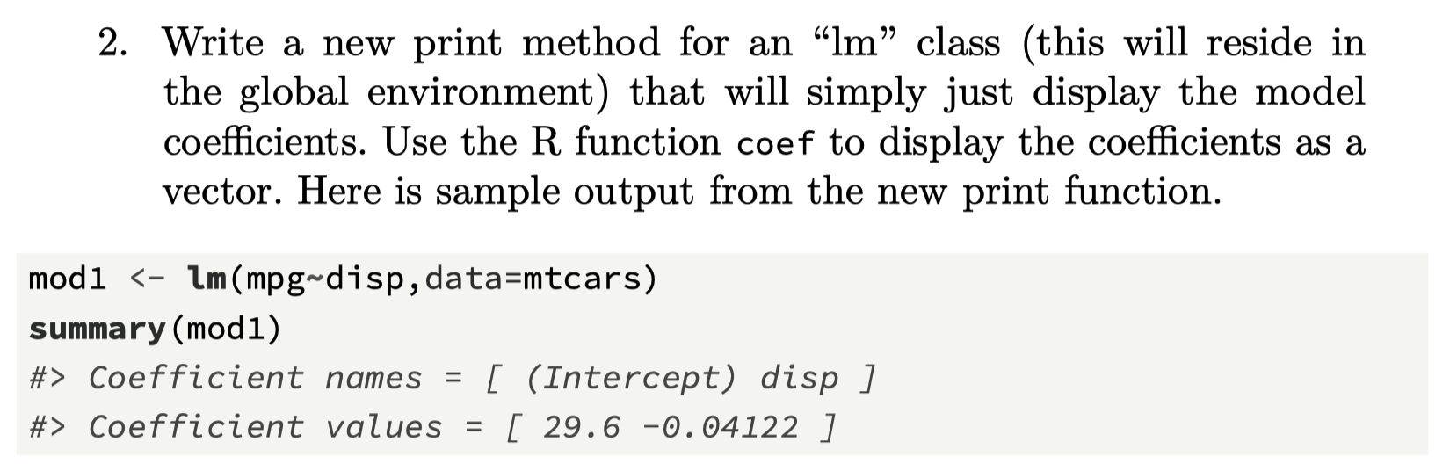
Challenge 6.1

Slide 20
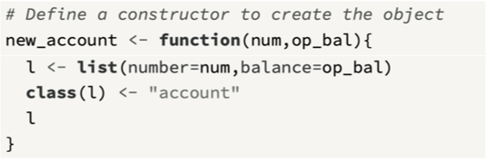
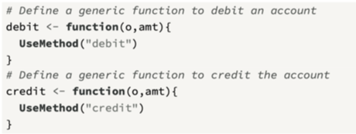
Example 2: Custom-built generic functions
Each object has a list structure that contains two variables, the account number and the balance.
A constructor is used to create a new account object.
The “account” class has two new generic functions: debit(), which reduces the balance by a given amount, credit(), which increases the balance.
There are three generic methods defined as
debit.account(),
credit.account() and
print.account()

Slide 21
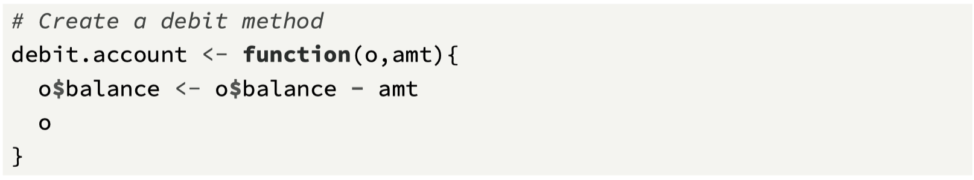
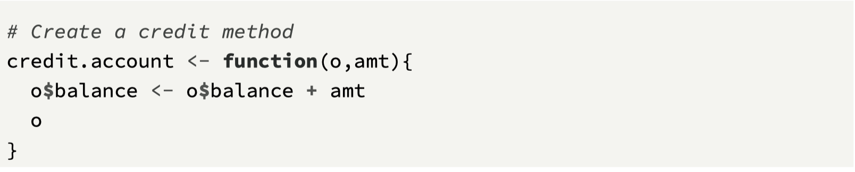
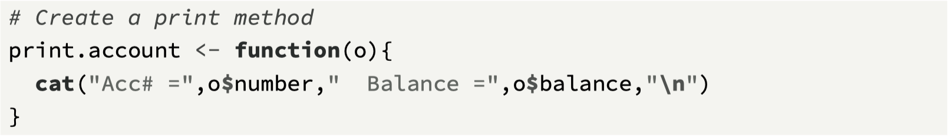
Adding methods for account class

Slide 22
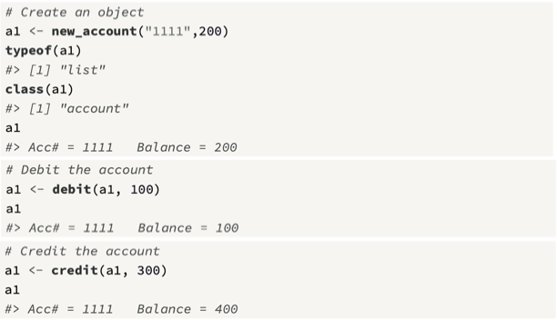
Calling the methods

Slide 23
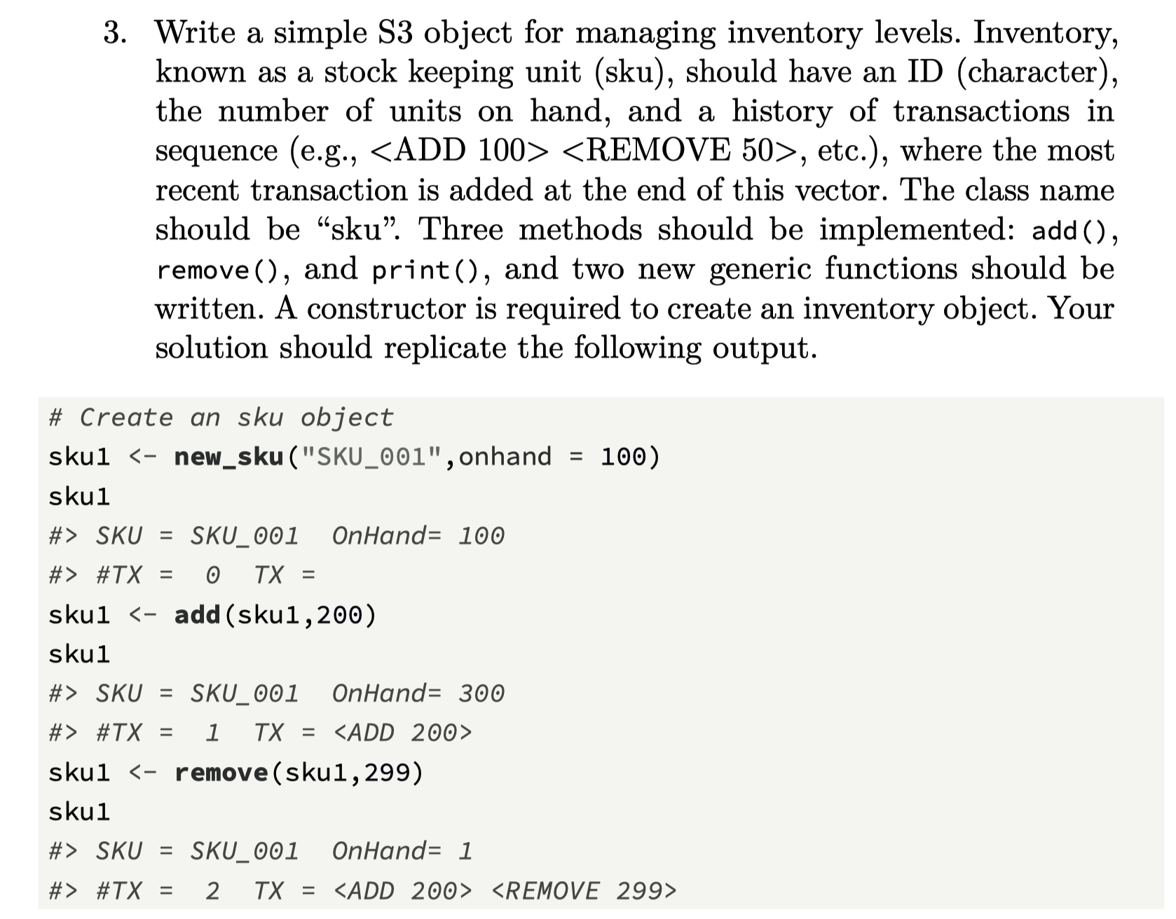
Challenge 6.2

Slide 24
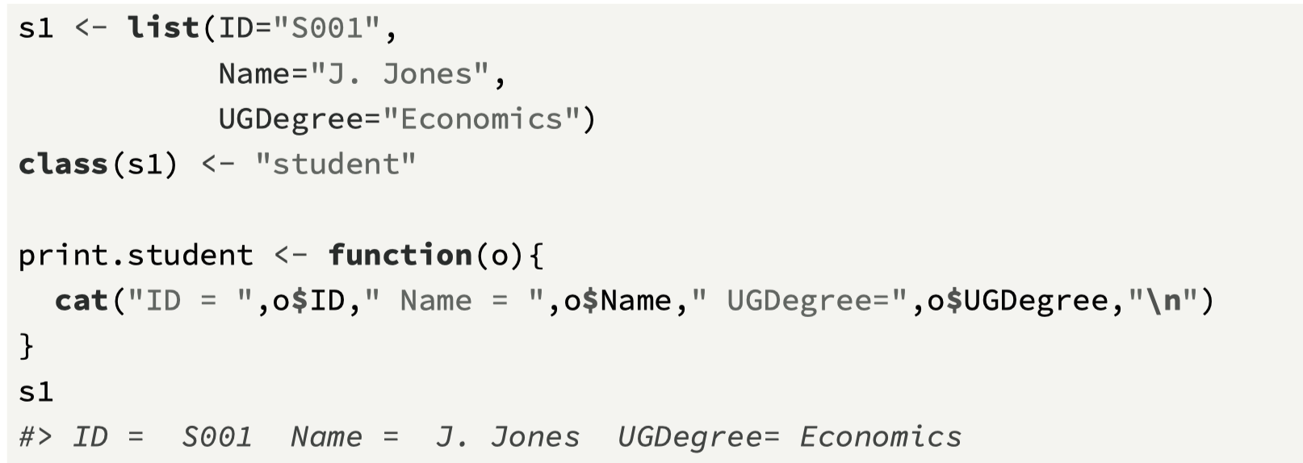
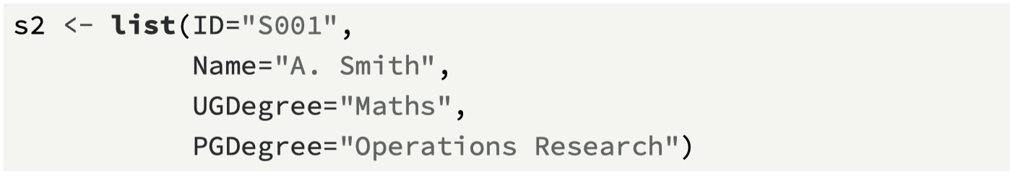
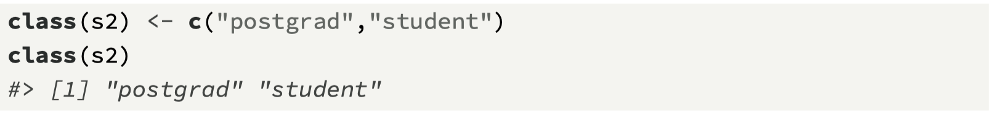
Inheritance with S3
In object-oriented languages, the idea of inheritance is to create new classes as specialized version of older ones (Matloff, 2011), and S3 provides this
The advantage of using inheritance is that the existing class methods of a superclass can be used by subclass.
To explore how inheritance works in S3, we first define what will be a superclass, which is the class “student”.
We define a subclass, post-graduate student

Slide 25
The impact of inheritance
Given that the relationship is established, we can now see the benefit of this structure. For example, all methods associated with the class “student” are now available for the class “postgrad”.
We can see this by calling the generic function print(s2) and observing the result.

Slide 26
Mechanism
The call to print is controlled by the method dispatch function in the generic function print().
Because the class attribute on the s2 object is a vector with two values, it takes the first value “postgrad” and searches for the function print.postgrad().
Because that function does not yet exist, it then moves to the superclass “student” and searches for the function print.student(), finds it, and calls it

Slide 27
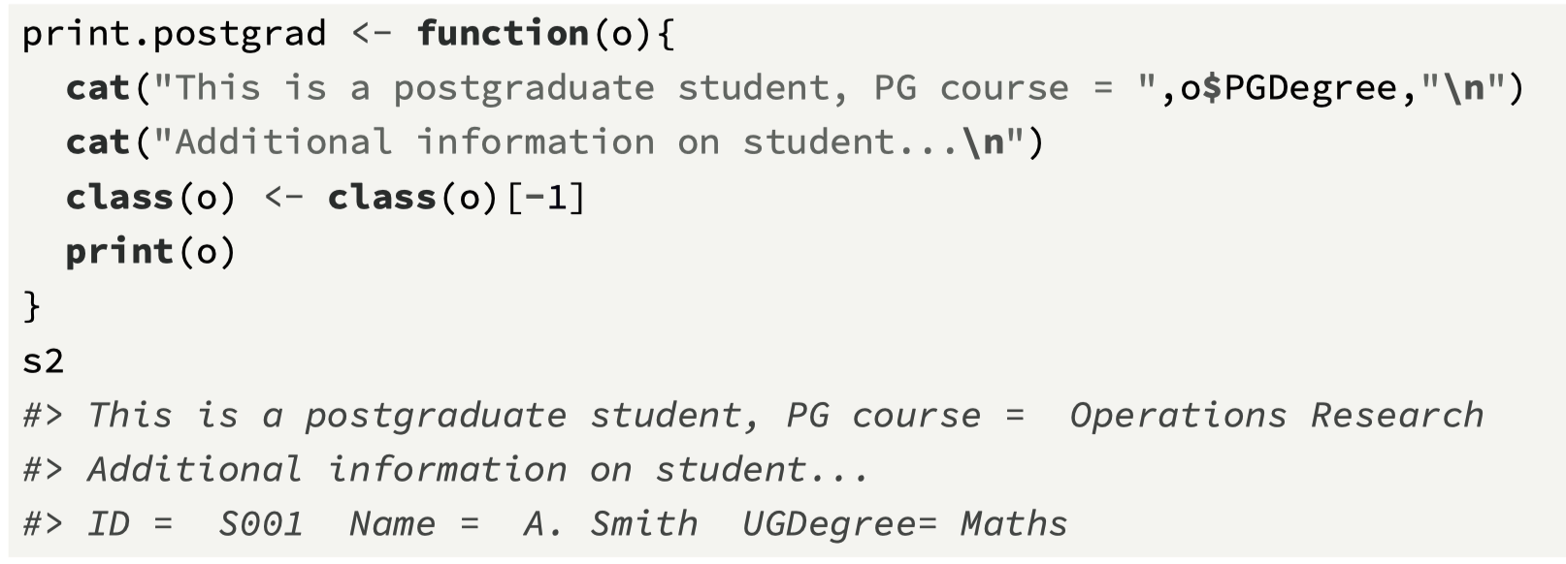
Adding a new method

Slide 28
Chapter 6 Recap
Base objects
Attributes, key 3: names, dim, and class
Defining a class
Generic functions and methods
Method dispatch and polymorphism
Inheritance
Next Challenge: extending the lm class
Next Topic: The tidyverse

Slide 29
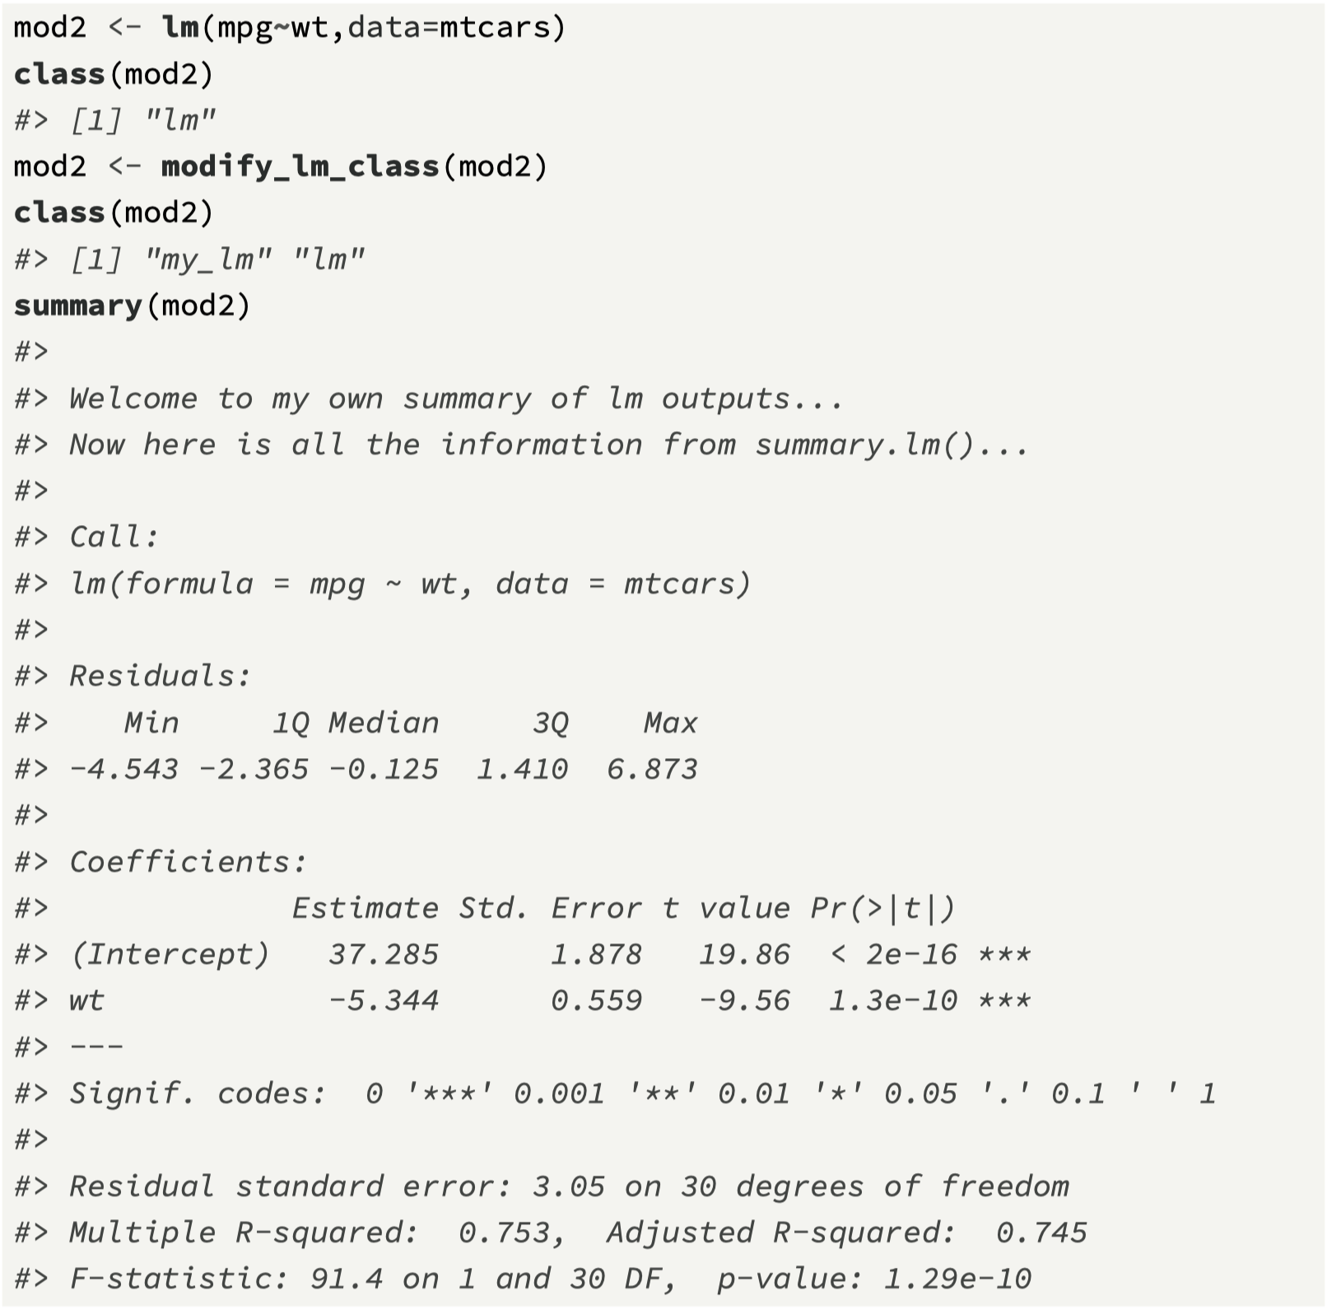
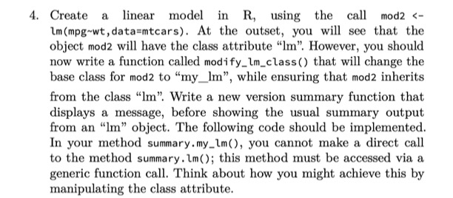
Challenge 6.3

